Slide 1
PORTFOLIO WEBSITE
BY
BALA SRI DURGA DANGETI

Slide 2
Content
1.Introduction
2.Technologies used in this website
3.What did I Learn?
4.Screen Shots Of this Website

Slide 3
Introduction
A portfolio is a form of Resume or CV. Portfolio is very useful for applying job online or you want to keep Your profile online

Slide 4
Technologies used in this website
1.HTML
2.CSS
3.BootStrap
4.Firefox Web Browser

Slide 5
What Did I Learn?
HTML from Basics
CSS and Bootstrap for creating web

Slide 6
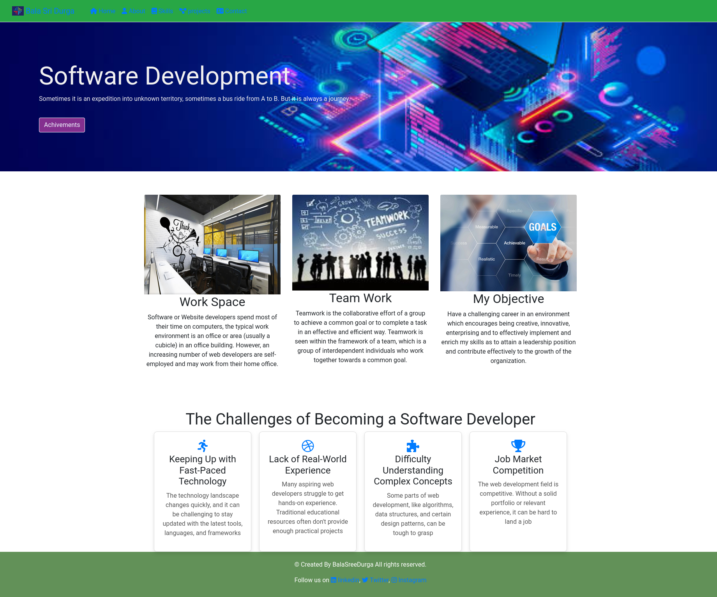

Slide 7
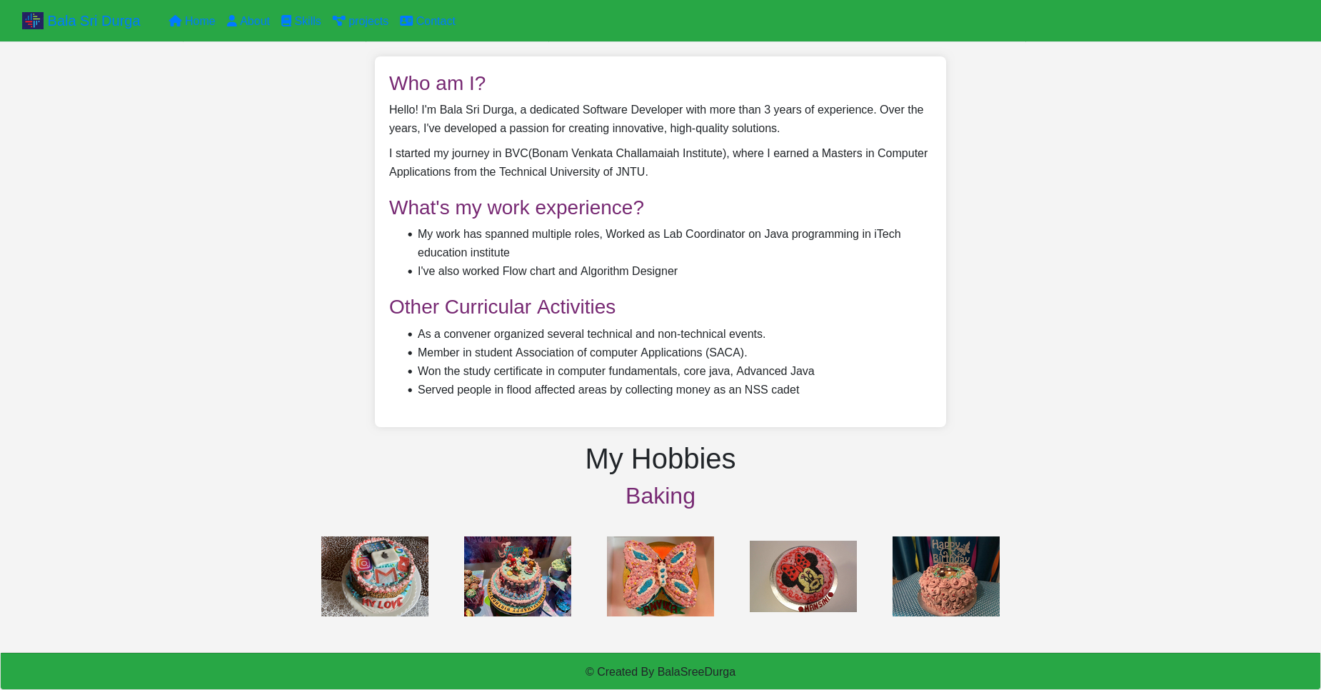

Slide 8
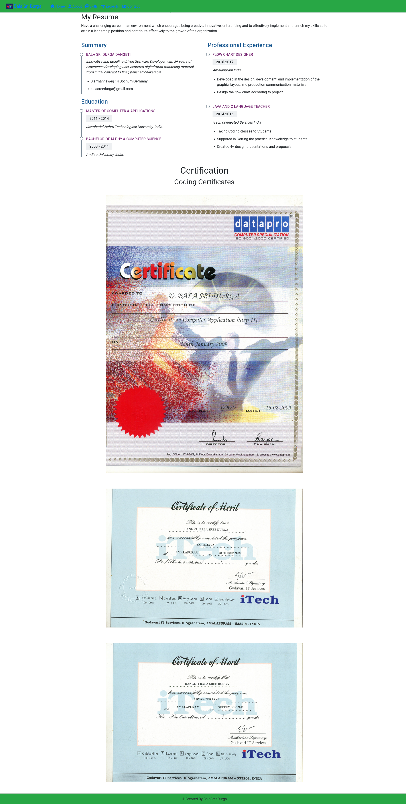

Slide 9
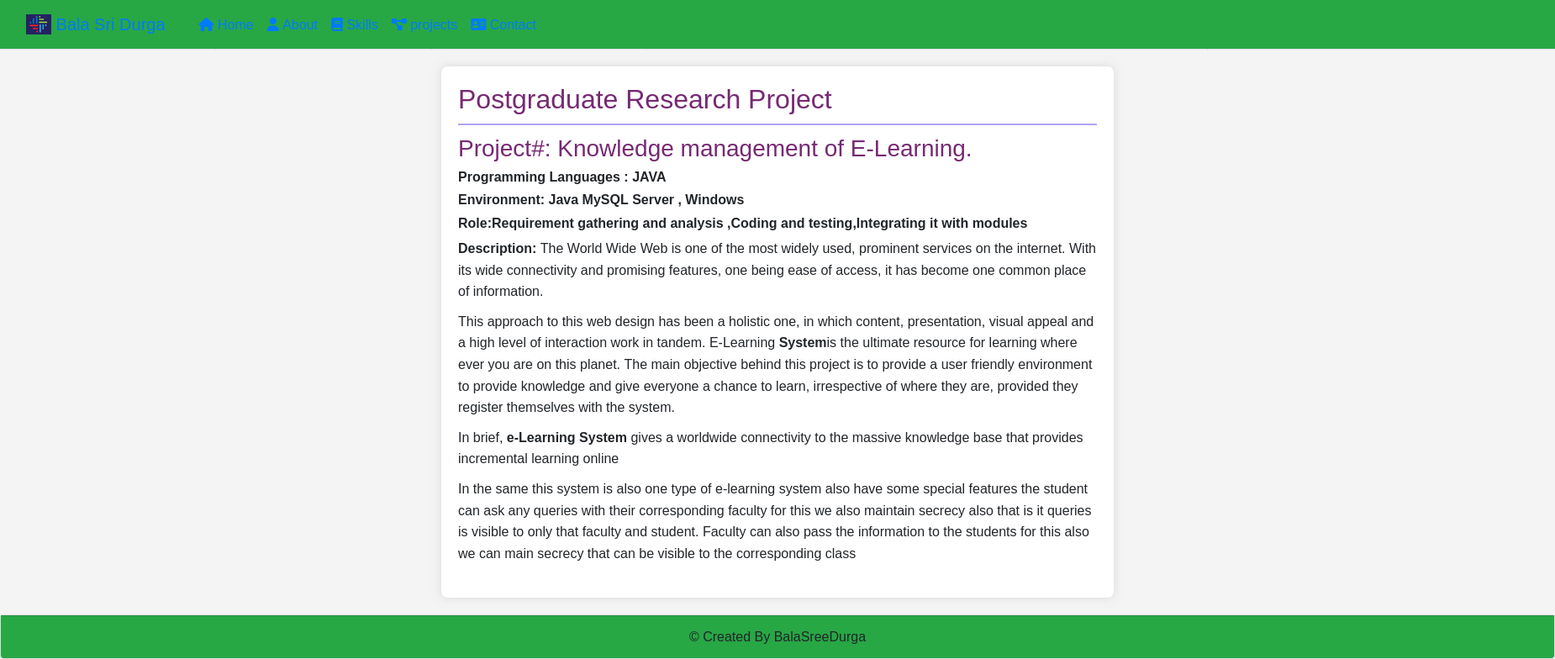

Slide 10


